Slide 1
Relational Model

Slide 2
Outline
Structure of Relational Databases
Database Schema
Keys
Schema Diagrams
Relational Query Languages
The Relational Algebra
Notes:
1

Slide 3
Relational Model Foundation
Relational Model of data is based on the concept of RELATION
A Relation is a Mathematical concept based on idea of SETS
The strength of the relational approach to data management comes from the formal foundation provided by the theory of relations
The model was first proposed by Dr. E.F. Codd of IBM in 1970

Slide 4
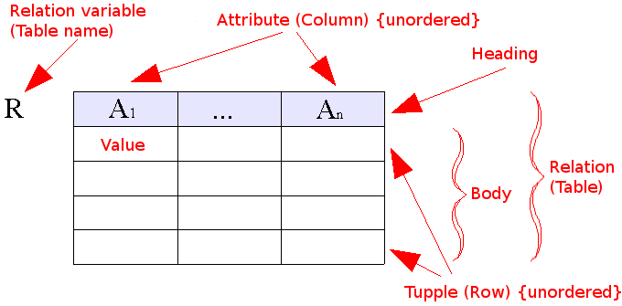
Relational Model (1970)
Data as set of tables
Having constraints and relationships
Oracle, DB2,Sybase

Slide 5
Some Terms
Informal Name
Table
Row or Record
Column or Field
No. of Rows
No. of Columns
Unique Identifier
Legal Values Set
Formal Name
Relation
Tuple
Attribute
Cardinality
Degree or Arity
Primary key
Domain

Slide 6
Relational Database: Definitions
Relational database: a set of relations
Relation: made up of 2 parts:
  Instance : a table, with rows and columns.
  #Rows = cardinality, #fields = degree / arity.
  Schema : specifies name of relation, plus name and type of each column.
    E.G. Students(sid: string, name: string, login: string, age: integer, gpa: real).
Can think of a relation as a set of rows or tuples (i.e., all rows are distinct).
Notes:
3

Slide 7
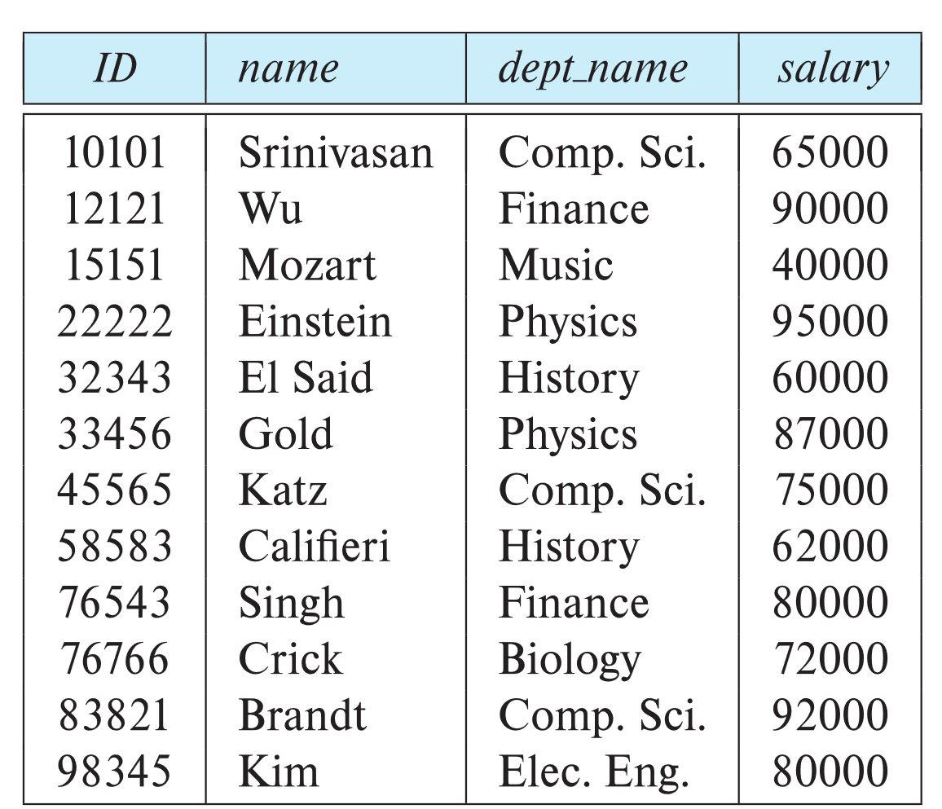
Example of a Instructor Relation
attributes
(or columns)
tuples
(or rows)

Slide 8
Relation Schema and Instance
A₁, A₂, …, A_{n} are attributes
R = (A₁, A₂, …, A_{n} ) is a relation schema
Example:
instructor = (ID, name, dept_name, salary)
A relation instance r defined over schema R is denoted by r (R).
The current values a relation are specified by a table
An element t of relation r is called a tuple and is represented by a row in a table
Notes:
1

Slide 9
Attributes
The set of allowed values for each attribute is called the domain of the attribute
Attribute values are (normally) required to be atomic; that is, indivisible
The special value null is a member of every domain. Indicated that the value is “unknown”
The null value causes complications in the definition of many operations

Slide 10
Null Values
Comparisons with null values return the special truth value null (unknown)
Three-valued logic using the truth value null:
  OR: (null OR true) = true
  (null OR false) = null
  (null OR null) = null
  AND: (true AND null) = null
  (false AND null) = false
  (null AND null) = null
  NOT: (NOT null) = null

Slide 11
Attributes
  An attribute is a characteristic
    Property, data element, field, attribute
    Ex: Student (name, IDNo, course credit)
  Domain
  Attributes can be
    Atomic (simple) vs. Composite
      Ex: Student ID , Student name
        Where student name may consists of (first, middle, last name)
    Single-valued vs. Multi-valued
      Ex. number of courses registered, names of registered courses
    Derived
      Ex: age of a student

Slide 12
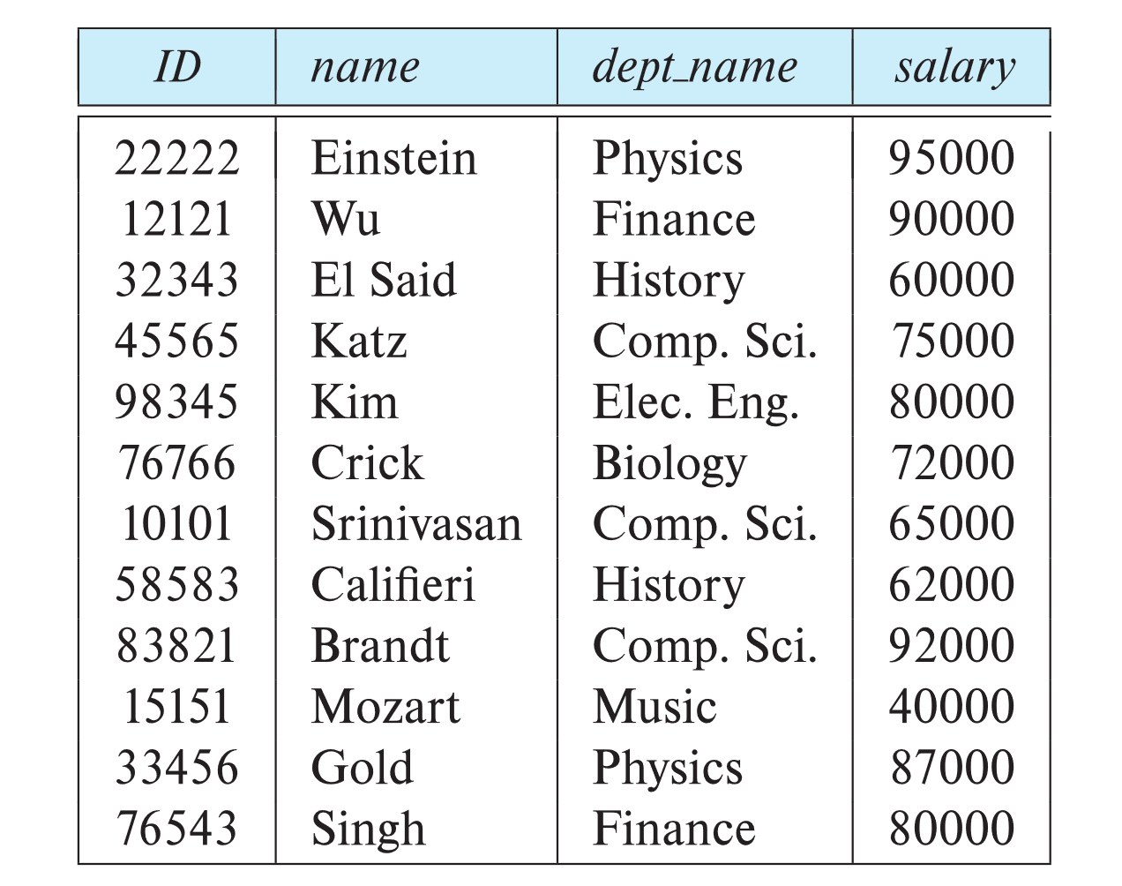
Relations are Unordered
Order of tuples is irrelevant (tuples may be stored in an arbitrary order)
Example: instructor relation with unordered tuples

Slide 13
Database Schema
Database schema -- is the logical structure of the database.
Database instance -- is a snapshot of the data in the database at a given instant in time.
Example:
  schema: instructor (ID, name, dept_name, salary)
  Instance:

Slide 14
Keys
Superkey (SK)
  Set of one or more attributes which taken collectively identifies uniquely an entity in a relation set
  Ex: Student ( student name, IDNo, CPI, program, address)
  Student relation set superkey can be (student name, IDNo)
  Superkey may contain extraneous attributes
  There can be more than one superkeys
Candidate Key (CK)
  A superkey for which no subset is a superkey
  Ex: IDNo is a Candidate Key as it is minimal and uniquely identifies a student from Student relation Set
  There can be more than one candidate keys

Slide 15
Keys
Primary Key (PK)
  Is a candidate key
  One of the candidate key is chosen by database designer as a primary key
Example
  Telephone Book( STD Code, Telephone number, Name, Address)
  Composite Key

Slide 16
Keys
Let K ⊆ R
K is a superkey of R if values for K are sufficient to identify a unique tuple of each possible relation r(R)
  Example: {ID} and {ID,name} are both superkeys of instructor.
Superkey K is a candidate key if K is minimal
Example: {ID} is a candidate key for Instructor
One of the candidate keys is selected to be the primary key.
  Which one?
Foreign key constraint: Value in one relation must appear in another
  Referencing relation
  Referenced relation
  Example: dept_name in instructor is a foreign key from instructor referencing department

Slide 17
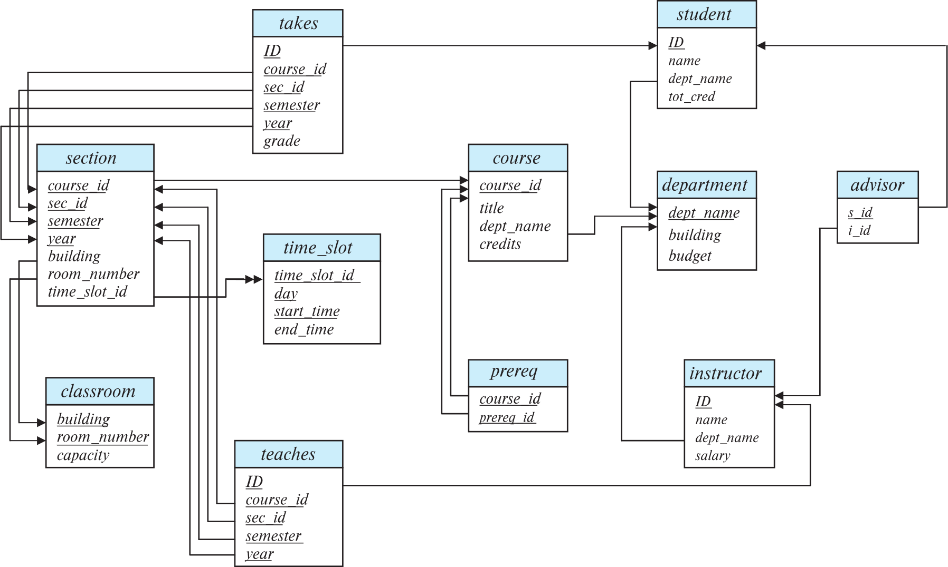
Schema Diagram for University Database

Slide 18
Schema of University Database
classroom(building, room number, capacity)
department(dept name, building, budget)
course(course id, title, dept name, credits)
instructor(ID, name, dept name, salary)
section(course id, sec id, semester, year, building, room number, time slot id)
teaches(ID, course id, sec id, semester, year)
student(ID, name, dept name, tot cred)
takes(ID, course id, sec id, semester, year, grade)
advisor(s ID, i ID)
time slot(time slot id, day, start time, end time)
Prereq (course id, prereq id)

Slide 19
Relational Query Languages
Procedural versus non-procedural, or declarative
“Pure” languages:
  Relational algebra
  Tuple relational calculus
  Domain relational calculus
The above 3 pure languages are equivalent in computing power
We will concentrate in this chapter on relational algebra
  Consists of 6 basic operations

Slide 20
Relational Algebra
A procedural language consisting of a set of operations that take one or two relations as input and produce a new relation as their result.
Six basic operators
  select: σ
  project: ∏
  union: ∪
  set difference: –
  Cartesian product: x
  rename: ρ

Slide 21
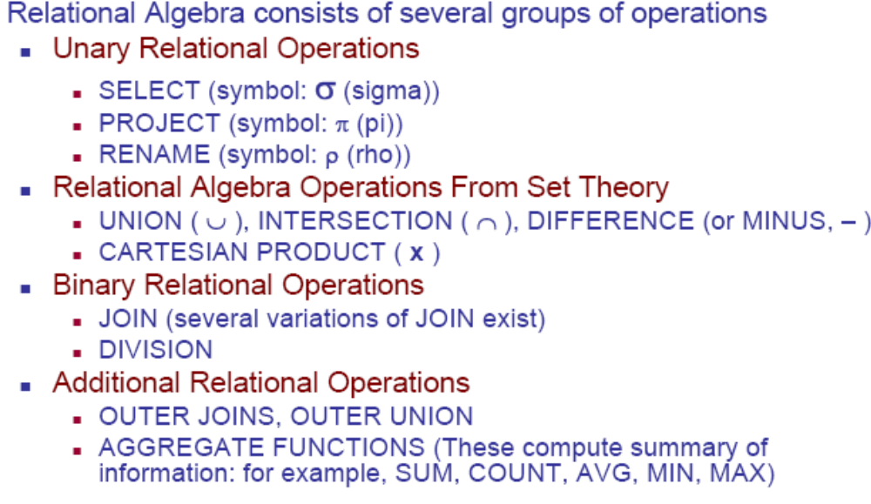
Relational Algebra Operators

Slide 22
Relational Algebra
Collection of operations on relations
8 operators + Rename operator
Codd’s 8 operators do not form a minimal set
Some of them are not primitive
Join, Intersect, & Divide can be defined in terms of other 5
None of these 5 can be defined in terms of the remaining 4

Slide 23
Restrict & Project
  select: σ
  project: ∏

Slide 24


Union, Intersection & Difference

Slide 25
Instructor

Slide 26
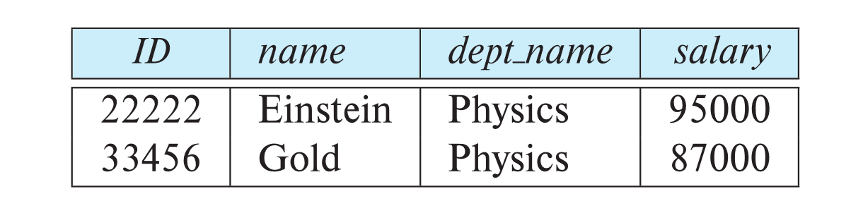
Select Operation
The select operation selects tuples that satisfy a given predicate.
Notation: σ _{p} (r)
p is called the selection predicate
Example: select those tuples of the instructor relation where the instructor is in the “Physics” department.
  Query
  σ _{dept_name=“Physics”} (instructor)
  Result

Slide 27
Select Operation
We allow comparisons using
=, ≠, >, ≥. <. ≤
in the selection predicate.
We can combine several predicates into a larger predicate by using the connectives:
∧ (and), ∨ (or), ¬ (not)
Example: Find the instructors in Physics with a salary greater 90,000, we write:
  σ _{dept_name=“Physics”} ∧ _{salary >} _{90,000} (instructor)
The select predicate may include comparisons between two attributes.
  Example, find all departments whose name is the same as their building name:
  σ _{dept_name=building} (department)

Slide 28
Project Operation
A unary operation that returns its argument relation, with certain attributes left out.
Notation:
∏ _{A1,A2,A3 ….Ak} (r)
where A₁, A₂, …, A_{k} are attribute names and r is a relation name.
The result is defined as the relation of k columns obtained by erasing the columns that are not listed
Duplicate rows removed from result, since relations are sets

Slide 29
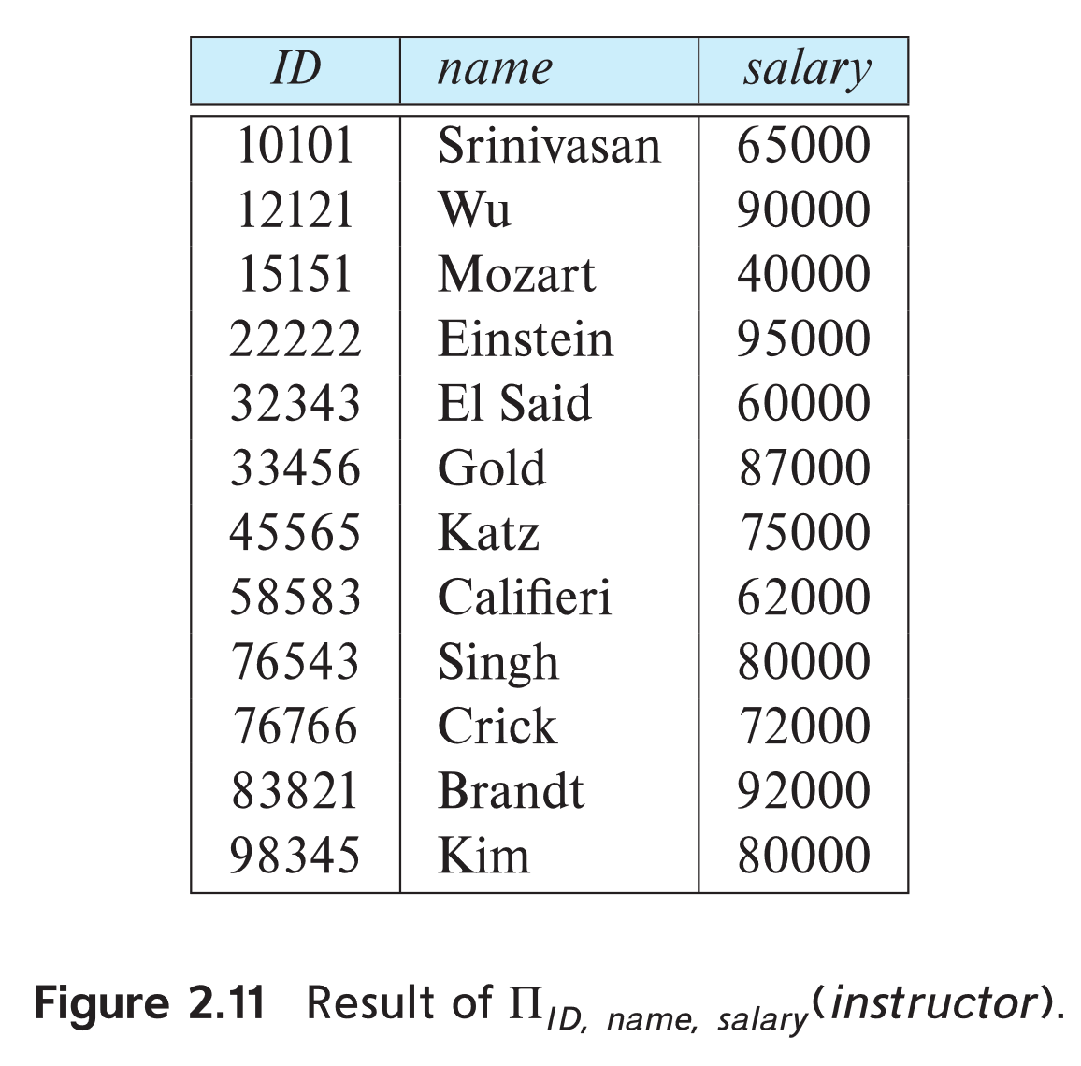
Project Operation Example
Example: eliminate the dept_name attribute of instructor
∏_{ID, name, salary} (instructor)
Result:

Slide 30
Composition of Relational Operations
The result of a relational-algebra operation is a relation and therefore relational-algebra operations can be composed together into a relational-algebra expression.
Find the names of all instructors in the Physics department.
∏_{name}(σ _{dept_name} _{=“Physics”} (instructor))
Instead of giving the name of a relation as the argument of the projection operation, we give an expression that evaluates to a relation.

Slide 31
Cartesian-Product Operation
The Cartesian-product operation (denoted by X) allows us to combine information from any two relations.
Example: the Cartesian product of the relations instructor and teaches is written as:
instructor X teaches
We construct a tuple of the result out of each possible pair of tuples: one from the instructor relation and one from the teaches relation
Since the instructor ID appears in both relations, we distinguish between these attributes by attaching to the attribute the name of the relation from which the attribute originally came.
  instructor.ID
  teaches.ID

Slide 32
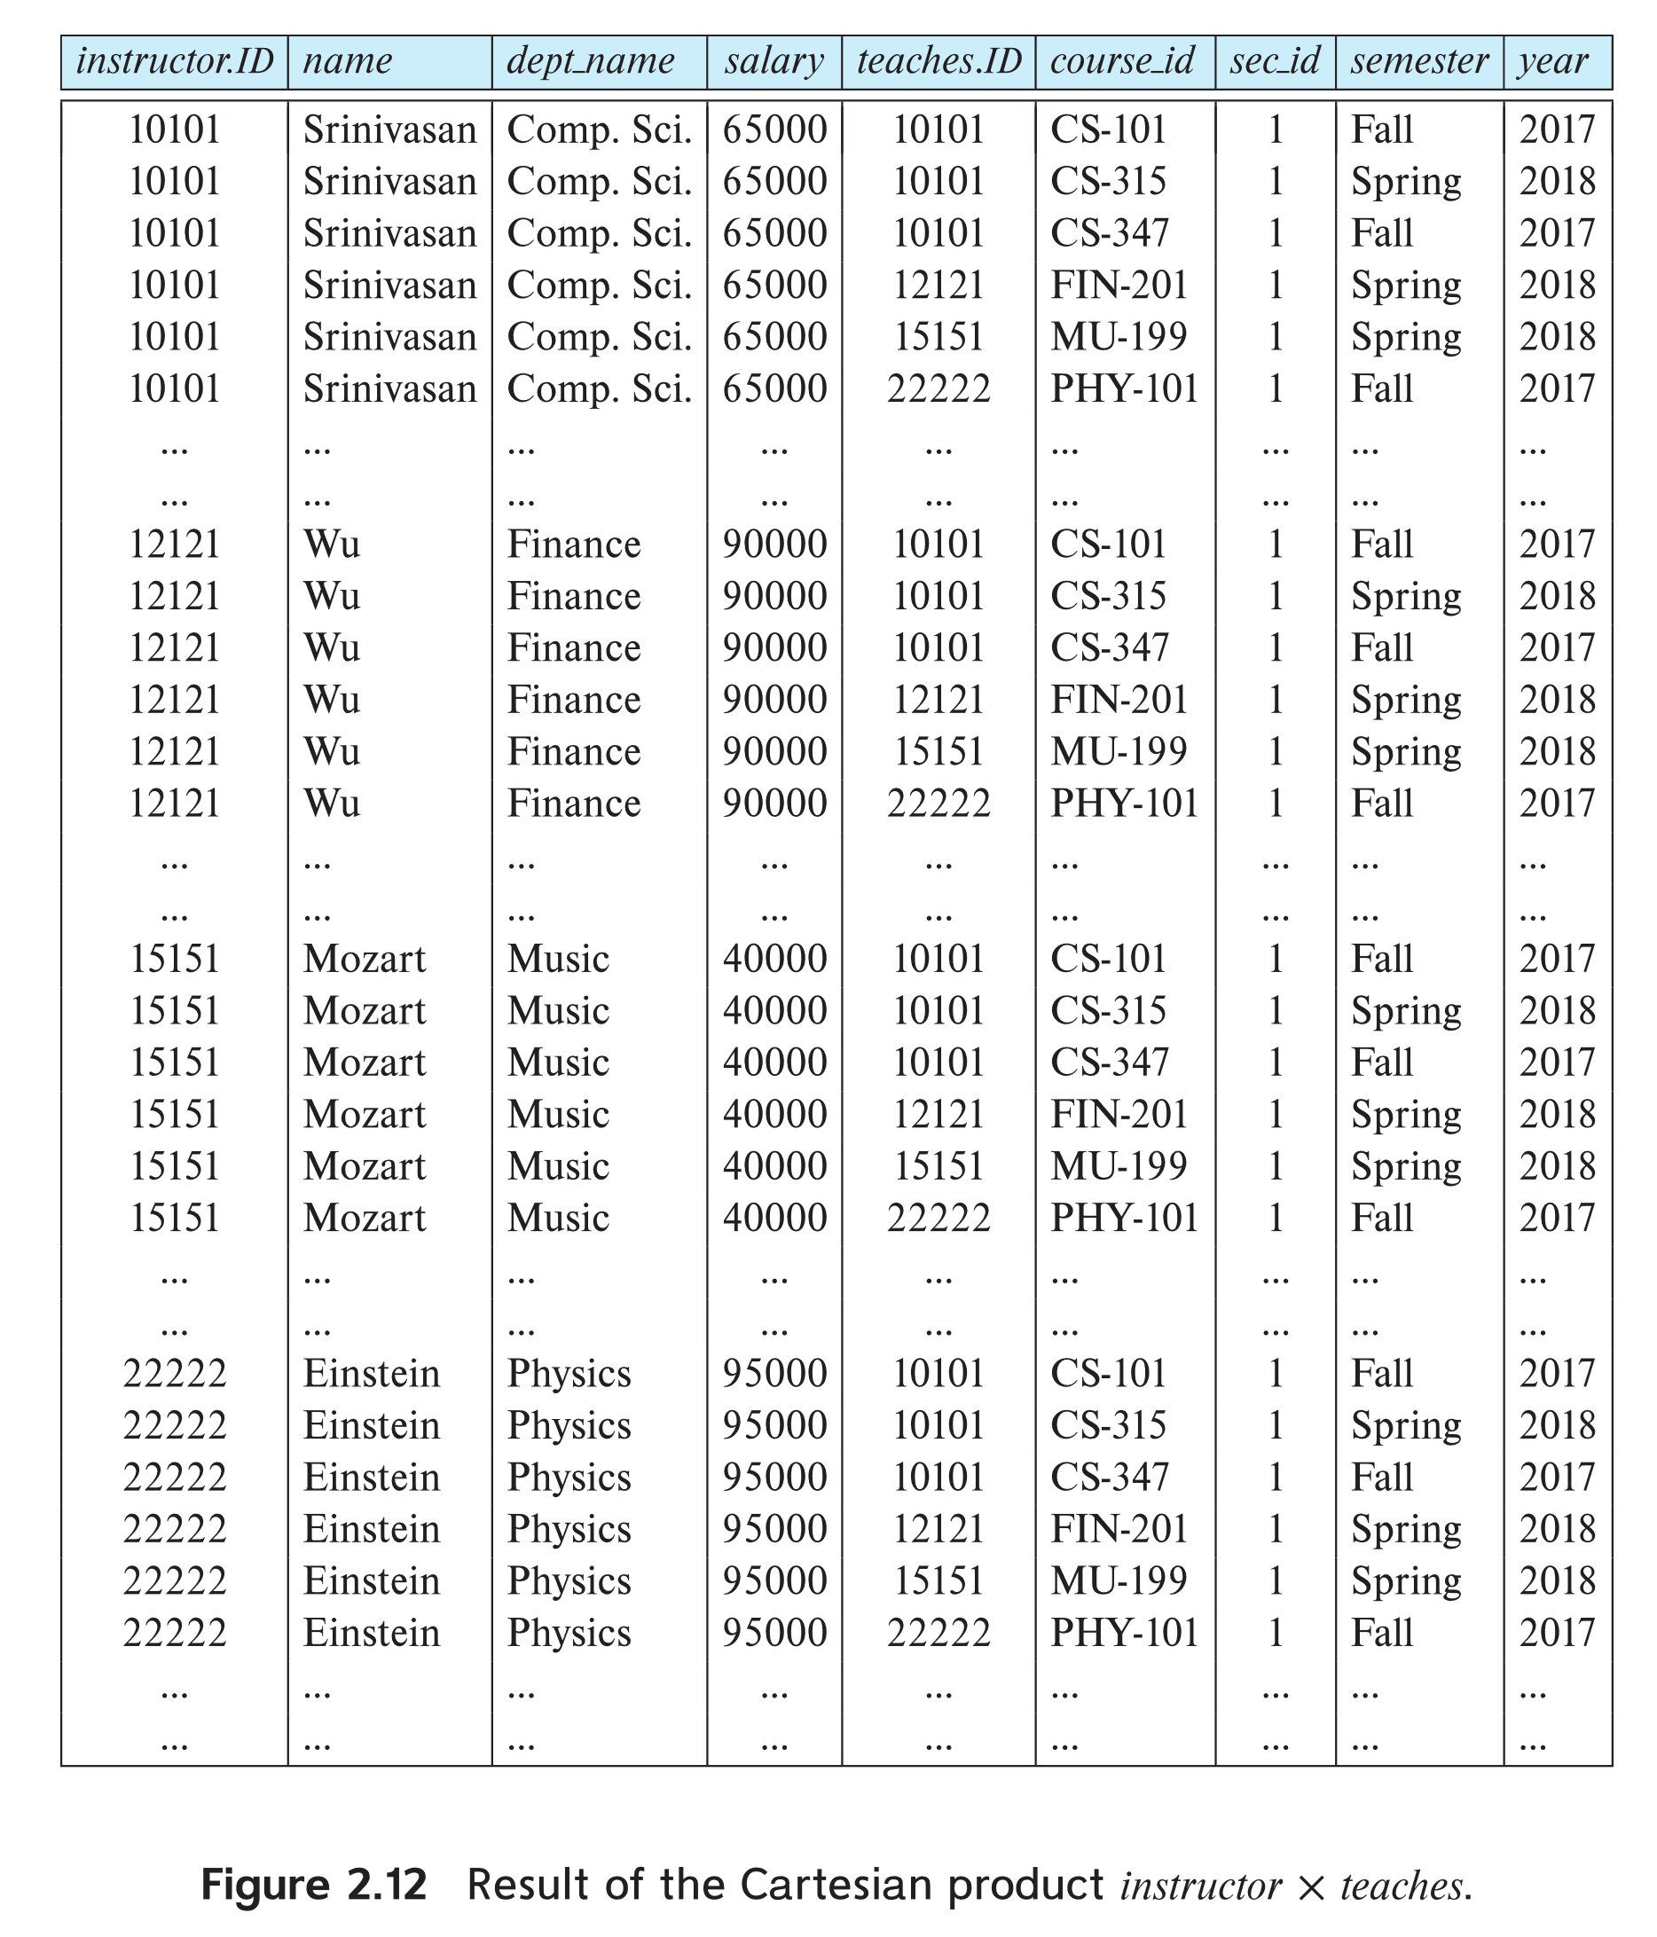
The instructor X teaches table

Slide 33
Join Operation
The Cartesian-Product
instructor X teaches
associates every tuple of instructor with every tuple of teaches.
  Most of the resulting rows have information about instructors who did NOT teach a particular course.
To get only those tuples of “instructor X teaches “ that pertain to instructors and the courses that they taught, we write:
σ _{instructor.id = teaches.id} (instructor x teaches ))
  We get only those tuples of “instructor X teaches” that pertain to instructors and the courses that they taught.

Slide 34
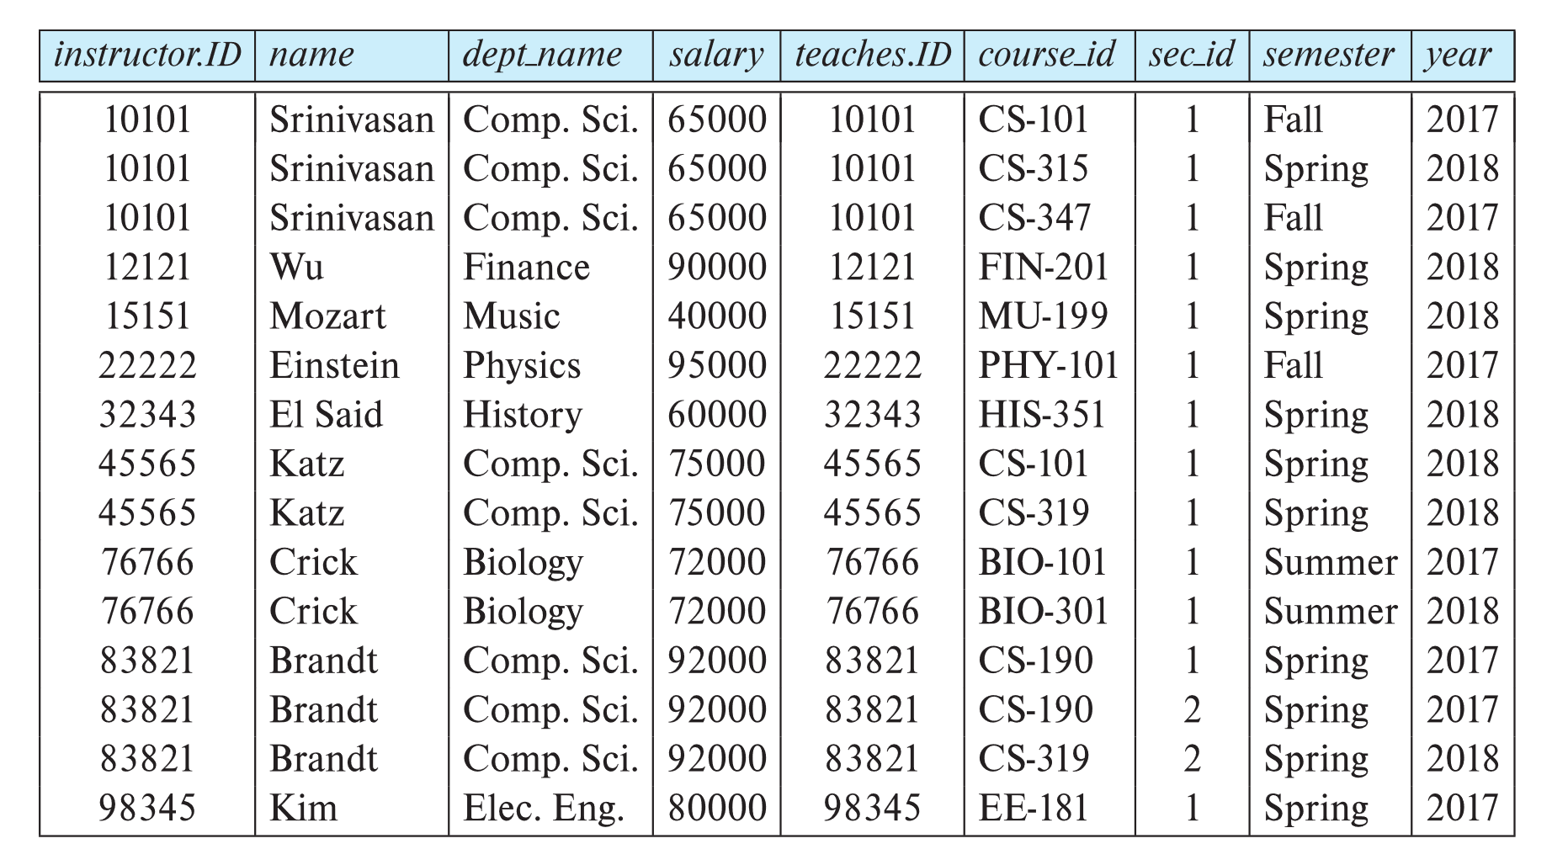
Join Operation (Cont.)
σ _{instructor.id = teaches.id} (instructor x teaches))

Slide 35
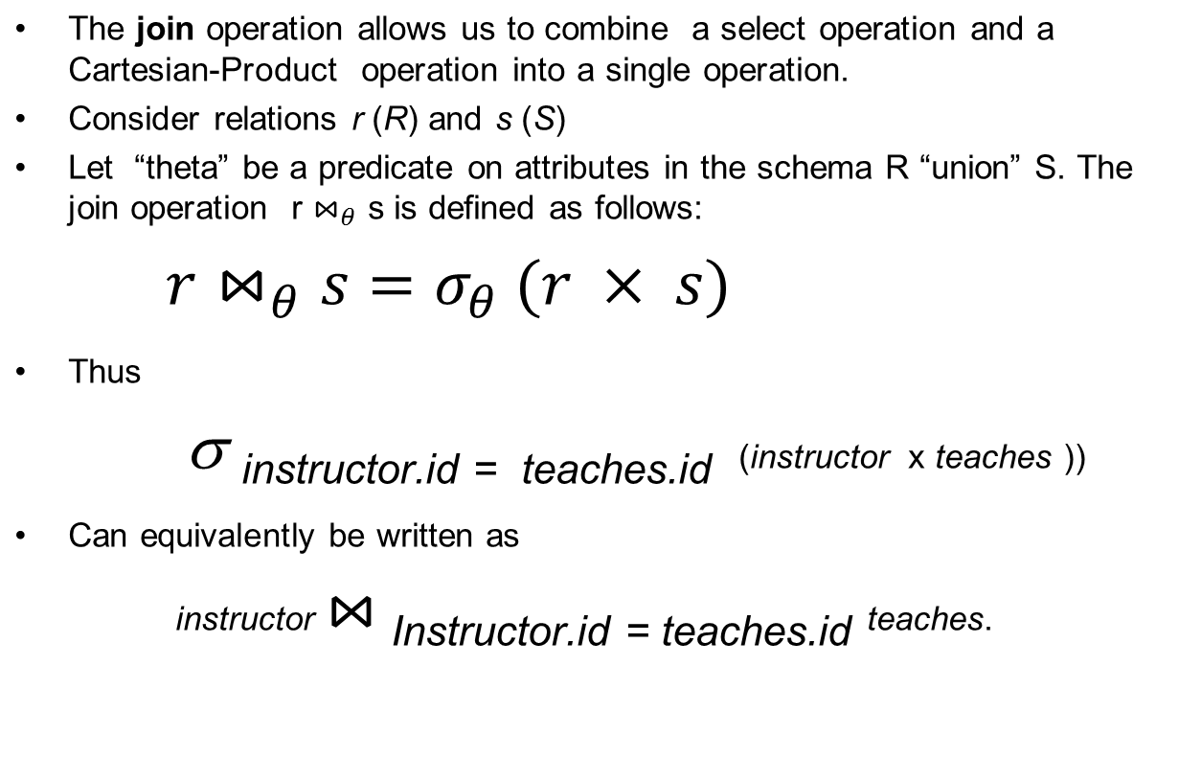
Join Operation (Cont.)

Slide 36
Union Operation
The union operation allows us to combine two relations
Notation: r ∪ s
For r ∪ s to be valid.
1. r, s must have the same arity (same number of attributes)
2. The attribute domains must be compatible (example: 2nd
  column of r deals with the same type of values as does the
  2nd column of s)
Example: to find all courses taught in the Fall 2017 semester, or in the Spring 2018 semester, or in both
∏_{course_id} (σ _{semester=“Fall” Λ year=2017} (section))
∪
∏_{course_id} (σ _{semester=“Spring” Λ year=2018} (section))

Slide 37
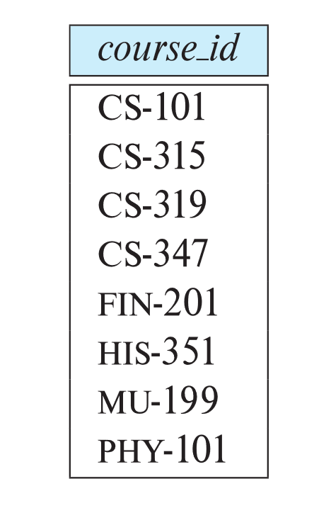
Union Operation
Result of:
∏_{course_id} (σ _{semester=“Fall” Λ year=2017} (section))
  ∪
  ∏_{course_id} (σ _{semester=“Spring” Λ year=2018} (section))

Slide 38
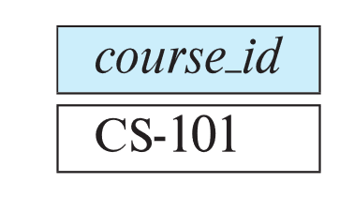
Set-Intersection Operation
The set-intersection operation allows us to find tuples that are in both the input relations.
Notation: r ∩ s
Assume:
  r, s have the same arity
  attributes of r and s are compatible
Example: Find the set of all courses taught in both the Fall 2017 and the Spring 2018 semesters.
∏_{course_id} (σ _{semester=“Fall” Λ year=2017} (section)) ∩
∏_{course_id} (σ _{semester=“Spring” Λ year=2018} (section))
  Result

Slide 39

Set Difference Operation
The set-difference operation allows us to find tuples that are in one relation but are not in another.
Notation r – s
Set differences must be taken between compatible relations.
  r and s must have the same arity
  attribute domains of r and s must be compatible
Example: to find all courses taught in the Fall 2017 semester, but not in the Spring 2018 semester
∏_{course_id} (σ _{semester=“Fall” Λ year=2017} (section)) −
∏_{course_id} (σ _{semester=“Spring” Λ year=2018} (section))

Slide 40
The Assignment Operation
It is convenient at times to write a relational-algebra expression by assigning parts of it to temporary relation variables.
The assignment operation is denoted by ← and works like assignment in a programming language.
Example: Find all instructor in the “Physics” and Music department.
Physics ← σ _{dept_name=“Physics”} (instructor)
  Music ← σ _{dept_name=“Music”} (instructor)
  Physics ∪ Music
With the assignment operation, a query can be written as a sequential program consisting of a series of assignments followed by an expression whose value is displayed as the result of the query.

Slide 41
The Rename Operation
The results of relational-algebra expressions do not have a name that we can use to refer to them. The rename operator, ρ , is provided for that purpose
The expression:
ρ_{x} (E)
returns the result of expression E under the name x
Another form of the rename operation:
ρ_{x(A1,A2, .. An)} (E)

Slide 42
Equivalent Queries
There is more than one way to write a query in relational algebra.
Example: Find information about courses taught by instructors in the Physics department with salary greater than 90,000
Query 1
σ _{dept_name=“Physics”} ∧ _{salary > 90,000} (instructor)
Query 2
σ _{dept_name=“Physics”} (σ _{salary > 90.000} (instructor))
The two queries are not identical; they are, however, equivalent -- they give the same result on any database.

Slide 43
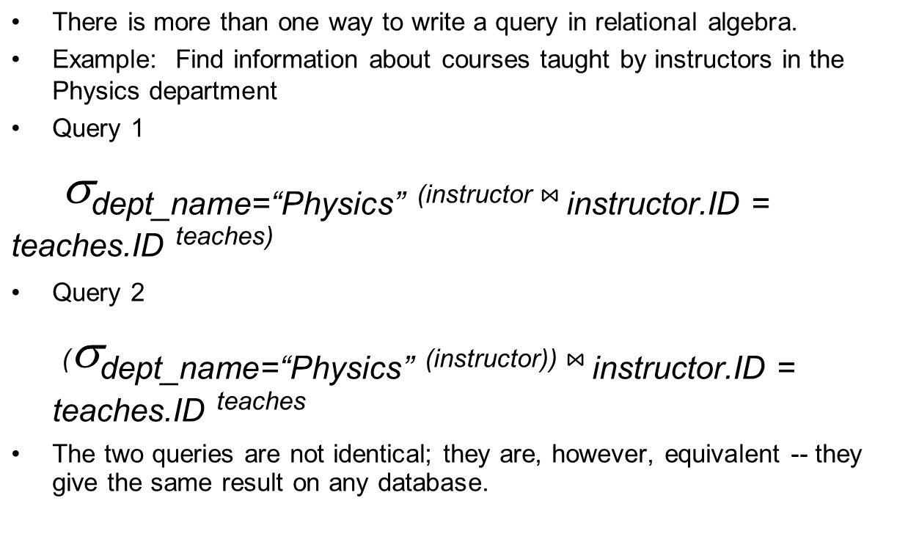
Equivalent Queries

Slide 44
Product & Divide
A
B
C
X
Y
A
A
B
B
C
C
X
Y
X
Y
X
Y
A
A
A
B
C
X
Y
Z
X
Y
X
Z
DIVIDE BY
A
PRODUCT

Slide 45

Division
S1
S1
S2
S2
S2
S2
S3
S4
S4
P1
P2
P3
P4
P1
P2
P2
P2
P4
P2
S1
S2
S3
S4
P2
P4
S2
S4
P1
P2
P4
S2

